Slide 1
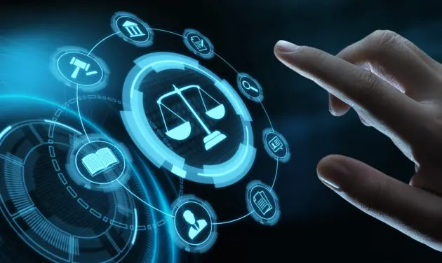
Basic Details of the Team and Idea
Idea :
Develop a mobile app leveraging image recognition and crowdsourced data to help users identify, track, and log local plant and animal species. It serves as an educational tool and a citizen-science platform to enhance biodiversity awareness and conservation efforts.

Slide 2
Idea Details
Feasibility :-
Leverages image recognition for species identification.
Enables species logging with GPS, time, and notes.
Data visualization for tracking ecosystem health.
Multilingual support for diverse user base.
AI-powered predictions for biodiversity threats.
Impact & Benefits :-
EcoVision is a mobile app designed to enhance biodiversity awareness. It empowers users to identify, log, and track local plant and animal species while contributing to global conservation efforts through crowdsourced data.
Biodiversity Awareness Citizen Science Engagement
Ecosystem Health Tracking
Endangered Species Conservation
Identifies and tracks species through image recognition technology, catering to diverse ecosystems across regions.
Supports multilingual functionality to ensure accessibility and inclusivity for users from different linguistic backgrounds.
Utilizes machine learning predictions based on historical data trends to enhance ecosystem health insights.
Provides a user-friendly interface, making it easy for users to log sightings, explore species, and engage with the community.
Technical Approach :-
Image Recognition: Utilizes computer vision (TensorFlow, Google Cloud Vision) to identify species from photos.
Data Logging: GPS tagging and user-friendly logging system for sightings.
AI Integration: Ecosystem health predictions using machine learning.
Offline Functionality: Ability to log sightings without internet access.
Cross-Platform: Built with React Native and Expo for mobile app development.
Backend: Scalable solutions using Node.js/Django and Firebase for real-time data.
Visualization: Interactive graphs using D3.js or Chart.js for ecosystem insights.
Expected Solution
The app is designed to leverage image recognition and crowdsourced data to help users identify, track, and log local plant and animal species. It serves as an educational tool and a platform for citizen science, contributing to the enhancement of biodiversity awareness and the conservation of species through smart data aggregation and insights.

Slide 3
Future Expansions
Potential Challenges
AR Integration: Use augmented reality to provide live information about species in the user's environment.
IoT Sensors: Integrate data from environmental sensors (e.g., water quality, temperature) for comprehensive ecosystem monitoring.
Collaborations: Partner with schools, NGOs, and governments to use the app for educational and conservation programs.
Data Accuracy: Ensure the AI correctly identifies species. Solution: Allow experts to verify species logs and crowdsource corrections.
Regional Diversity: Cover a wide range of species globally. Solution: Collaborate with local biodiversity databases and researchers.
User Engagement: Ensure regular app usage. Solution: Use gamification and social features to encourage participation.
Limited Internet Access: Provide offline functionality for remote areas. Solution: Preload regional species data and enable offline syncing.
MVP (Minimum Viable Product)
1. A basic mobile app that:
- Identifies species from images.
- Logs sightings with GPS and time.
- Displays species on a map.
2. Use pre-trained models for image recognition (e.g., MobileNet).
3. Show a dashboard with biodiversity insights.

Slide 4
Research & References
J. U. M. Akbar, S. F. Kamarulzaman, A. J. M. Muzahid, M. A. Rahman and M. Uddin, "A Comprehensive Review on Deep Learning Assisted Computer Vision Techniques for Smart Greenhouse Agriculture," in IEEE Access, vol. 12, pp. 4485-4522, 2024, doi: 10.1109/ACCESS.2024.3349418.keywords: {Green products;Computer vision;Farming;Agriculture;Crops;Deep learning;Air pollution;Agriculture;Convolutional neural networks;Image segmentation;Precision agriculture;Object detection;Agricultural automation;computer vision;deep learning;convolutional neural networks(CNN);controlled-environment agriculture (CEA);greenhouse farming;smart farming;smart agriculture;precision agriculture;image classification;image segmentation;object detection},
Q. Qing, X. Li and L. Zhang, "FeatureFlow Transformer: Enhancing Feature Fusion and Position Information Modeling for Hyperspectral Image Classification," in IEEE Access, vol. 12, pp. 127685-127701, 2024, doi: 10.1109/ACCESS.2024.3455369.keywords: {Feature extraction;Transformers;Field-flow fractionation;Convolutional neural networks;Tensors;Hyperspectral imaging;Encoding;Flow feature fusion;rotary position embedding;transformer;hyperspectral image classification},
E. Cioroaica, B. Buhnova and E. Tomur, "Towards Trusting the Ethical Evolution of Autonomous Dynamic Ecosystems," 2022 IEEE/ACM 1st International Workshop on Software Engineering for Responsible Artificial Intelligence (SE4RAI), Pittsburgh, PA, USA, 2022, pp. 13-16, doi: 10.1145/3526073.3527585. keywords: {Ethics;Conferences;Ecosystems;Computer architecture;Behavioral sciences;Artificial intelligence;Software engineering;Trust;Digital Ecosystems;Simulation;Ethics;Morality;Artificial Agent;AI},
E. Moupojou, F. Retraint, H. Tapamo, M. Nkenlifack, C. Kacfah and A. Tagne, "Segment Anything Model and Fully Convolutional Data Description for Plant Multi-Disease Detection on Field Images," in IEEE Access, vol. 12, pp. 102592-102605, 2024, doi: 10.1109/ACCESS.2024.3433495.keywords: {Plant diseases;Accuracy;Convolutional neural networks;Training;Task analysis;Object recognition;Plantations;Plants (biology);Detection algorithms;Field plant images;fully convolutional data description;laboratory images;plant disease dataset;plant disease detection and classification;segment anything model},

Slide 5
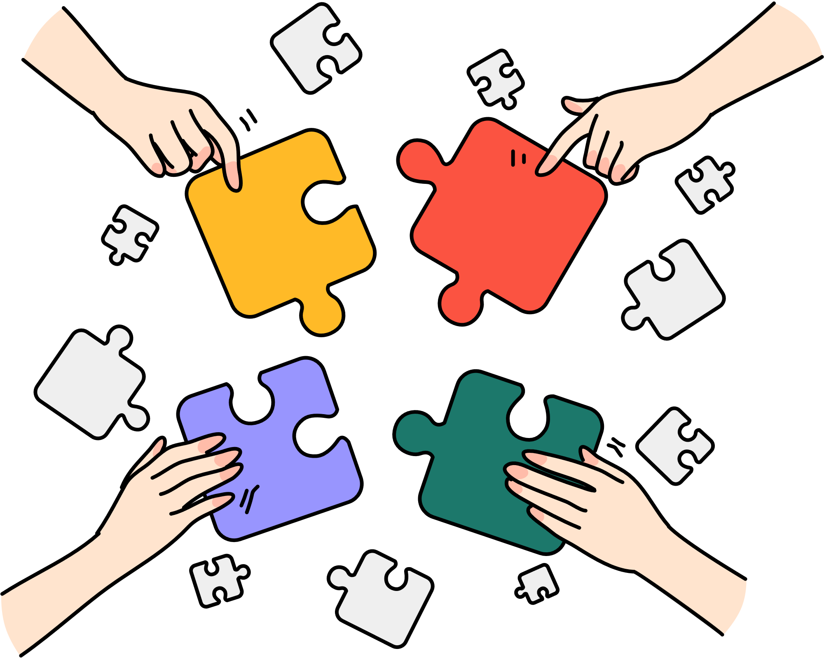
Team Details
Team leader Name : Mr. Anubhav Tripathi Branch : AI-ML
Team Member 1 Name : Mr. Harshit Singh Branch : CSE-DS
Team Member 3 Name : Ms. Anushka Tyagi Branch : CSE
Team Mentor Name : Dr. Jaya Sinha (HOD – CSE AIML & DS) , Dr. Vishnu Sharma (DEAN CSE)
ITS Engineering College, Knowledge Park 3, Greater Noida
Expertise : Machine Learning & Deep Learning

